Slide 1
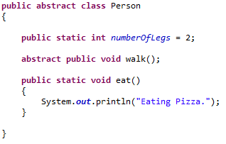
Abstract Methods and Classes
An abstract class may have static fields and static methods. We can use these static members with a class reference

